Slide 1
BB2950 Day 8: Monday 11-6-17
Learning objectives:
Describe the composition of viral, prokaryotic, and eukaryotic genomes with respect to size, ploidy, gene content, intron usage, transposon content, and chromosome shape.
Describe DNA supercoiling, the purpose it serves in cells, and the processes that introduce and relax supercoils.

Slide 2
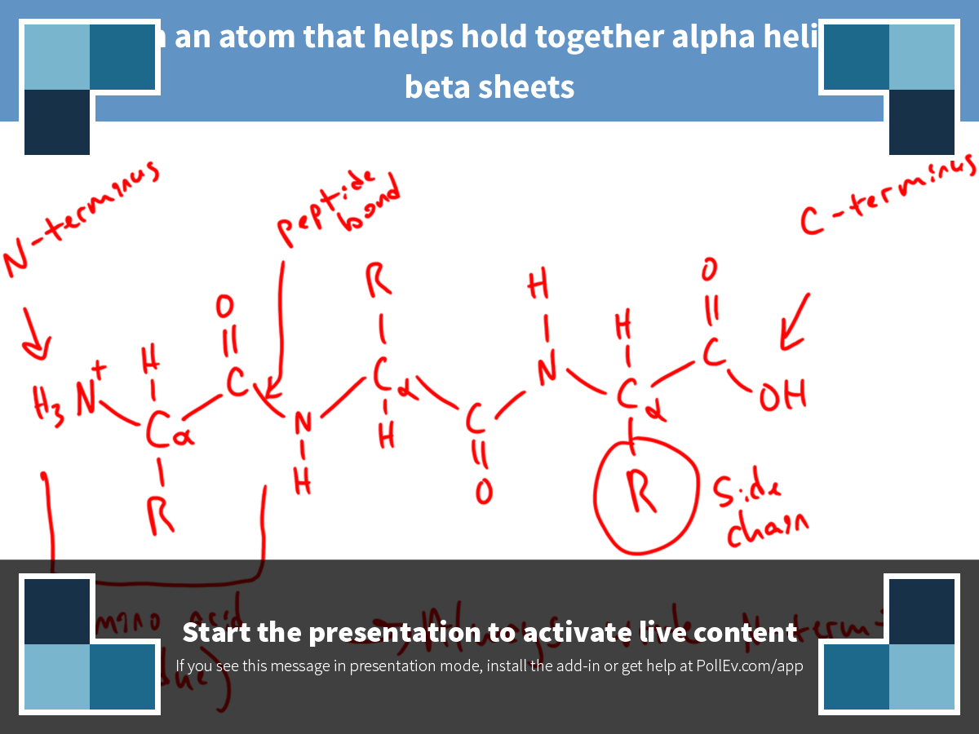
Notes:
Click on an atom that helps hold together alpha helices and beta sheets
https://www.polleverywhere.com/clickable_images/s7BqsEDlLknyRwv

Slide 3
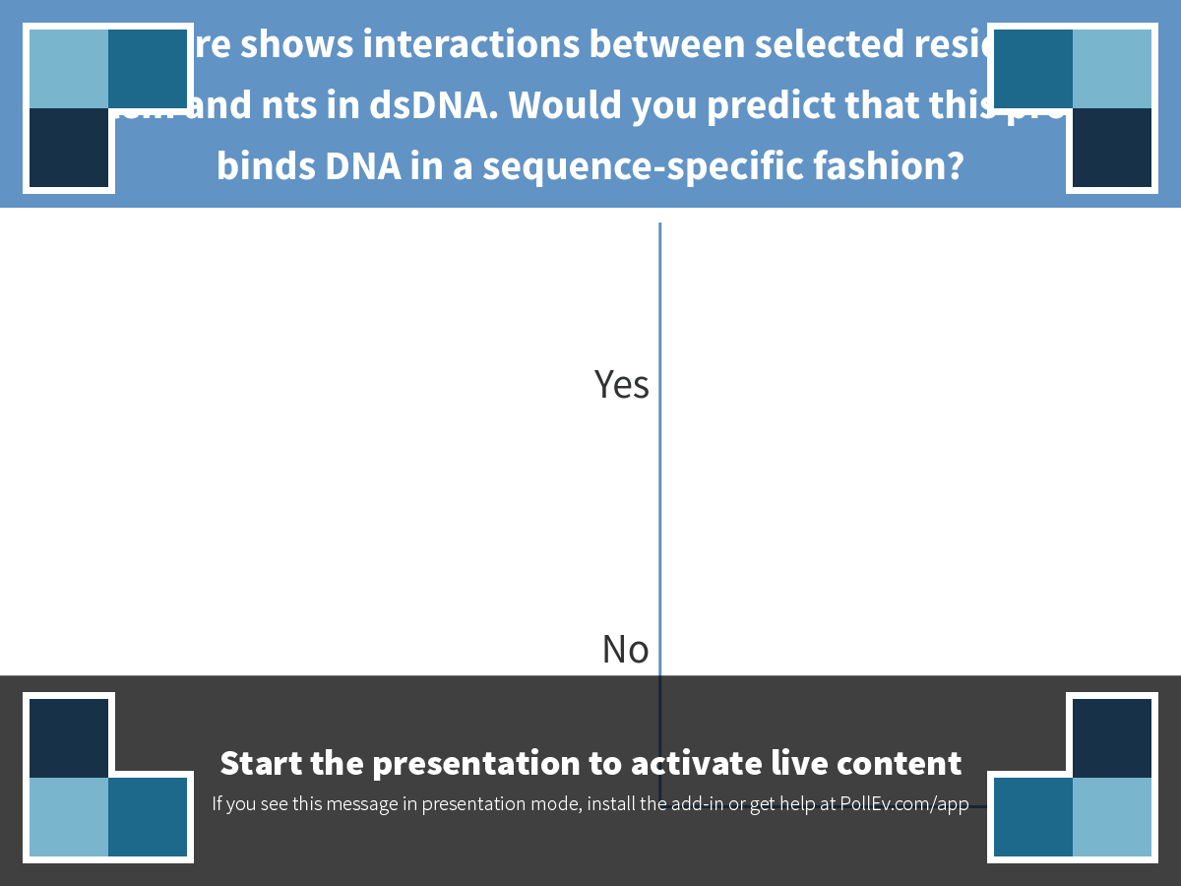
Notes:
This figure shows interactions between selected residues of a protein and nts in dsDNA. Would you predict that this protein binds DNA in a sequence-specific fashion?
https://www.polleverywhere.com/multiple_choice_polls/YGy9VEgY89N351C

Slide 4
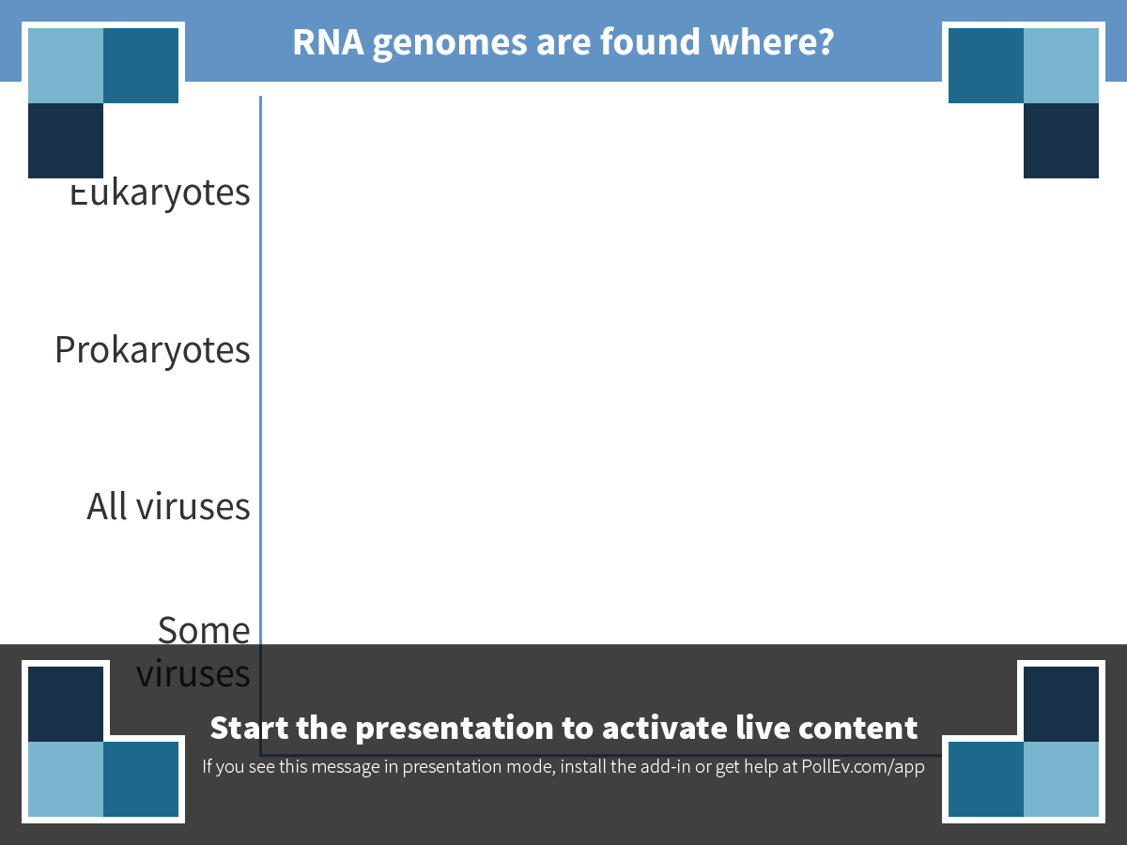
Notes:
RNA genomes are found where?
https://www.polleverywhere.com/multiple_choice_polls/JmM3nBsfhKEWMdM

Slide 5
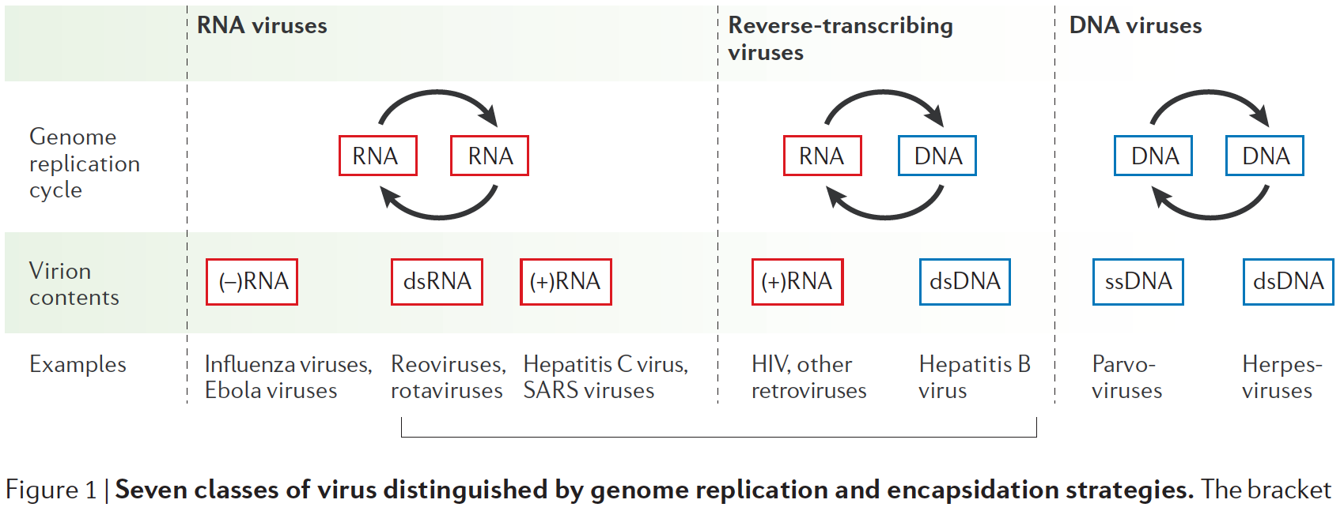
Viral genomes and replication strategies
Ahlquist, P. (2006) Nature Reviews Microbiology, 4(5), 371–382. http://doi.org/10.1038/nrmicro1389

Slide 6
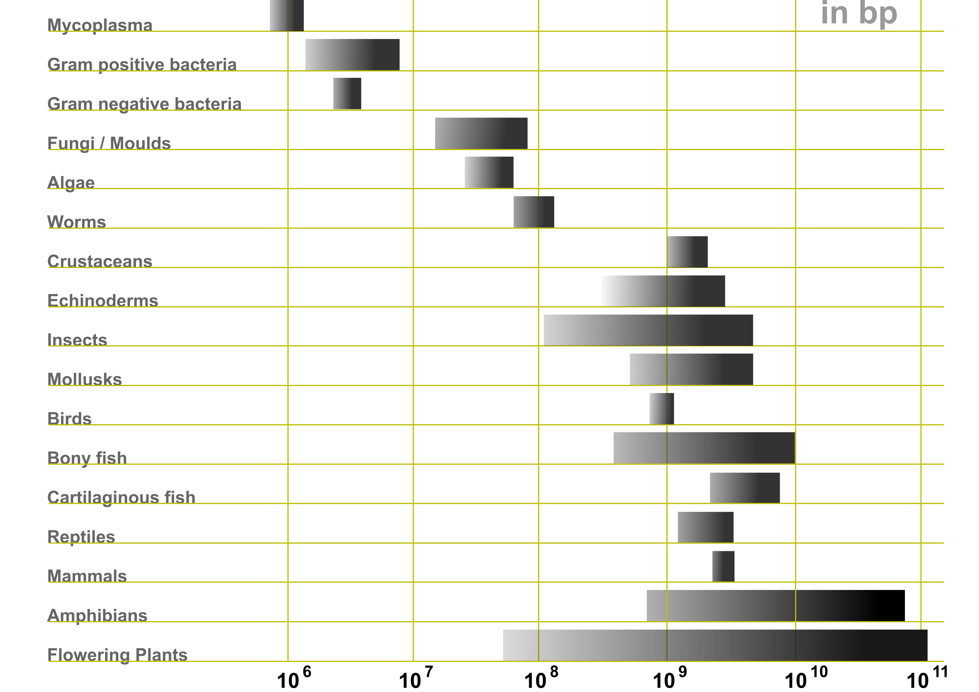
The spectrum of (haploid) genome sizes
(Viruses: ~10³ – 10⁵ bp)
Microbiology: An Evolving Science. Third Edition.

Slide 7
The spectrum of cellular genome structures
 | Prokaryotes | Eukaryotes
Chromosome shape | Usually circular | Linear
Plasmids | More frequent | Less frequent
Ploidy | Haploid | Variable
Protein coding content | ~80% | Variable (often much less)
Introns | Rare | Common

Slide 8
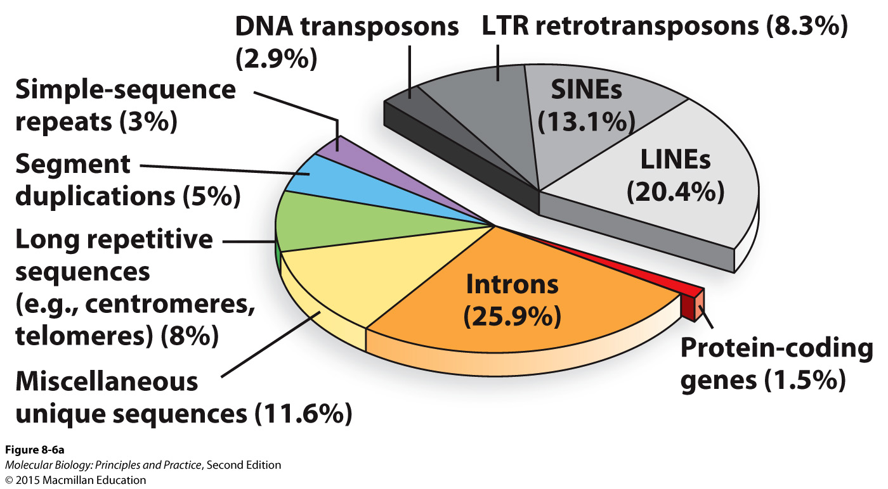
Composition of the human genome

Slide 9
Transposons
<5% of a typical bacterial genome, ~46% of the human genome

Slide 10
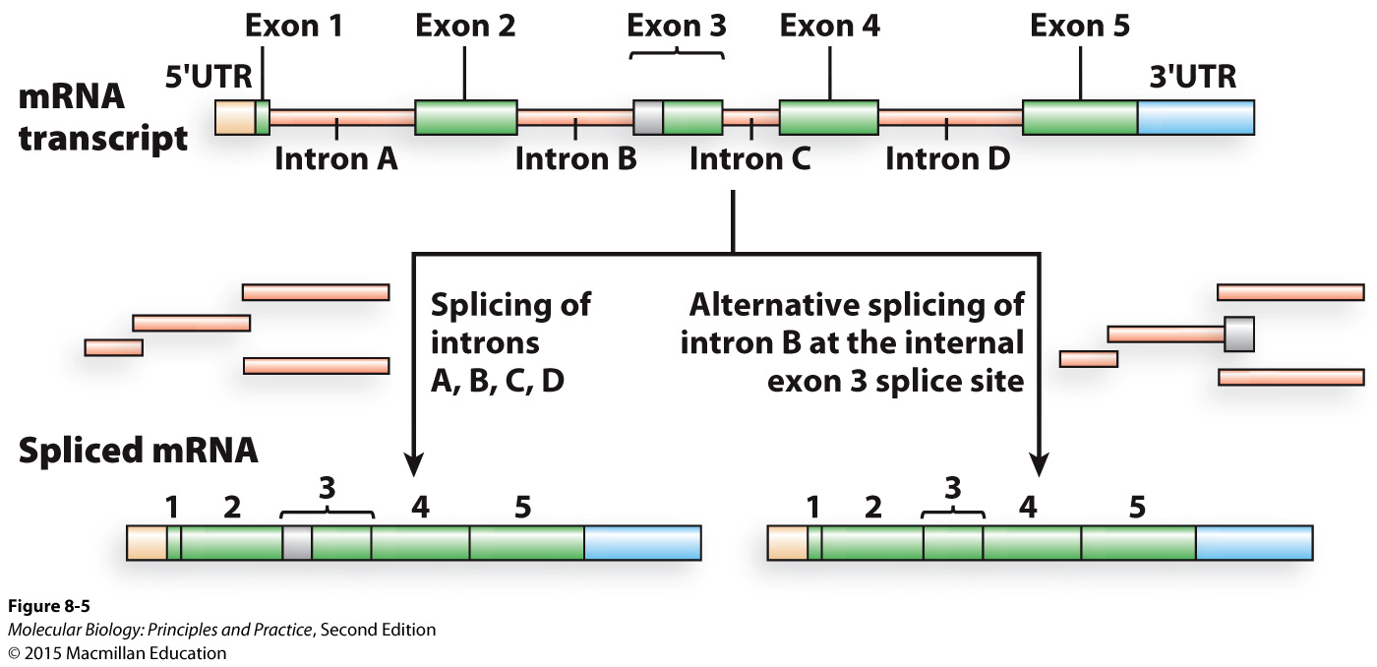
A typical mammalian gene structure
Because of alternative splicing, ~20,000 human genes encode >>20,000 unique polypeptides

Slide 11
DNA compaction: fitting almost 2 m of DNA into a few microns
Notes:
Supercoiling
DNA binding proteins

Slide 12
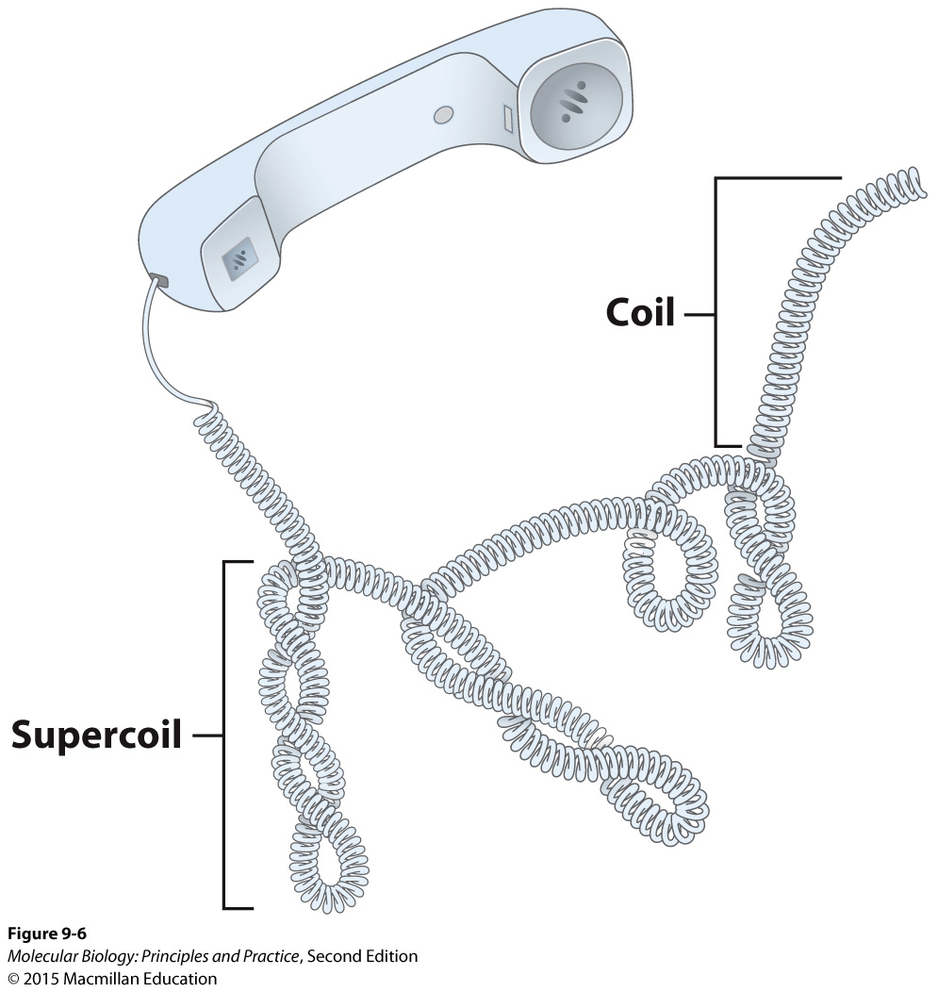
The trouble with cell phones is you can’t do this:

Slide 13
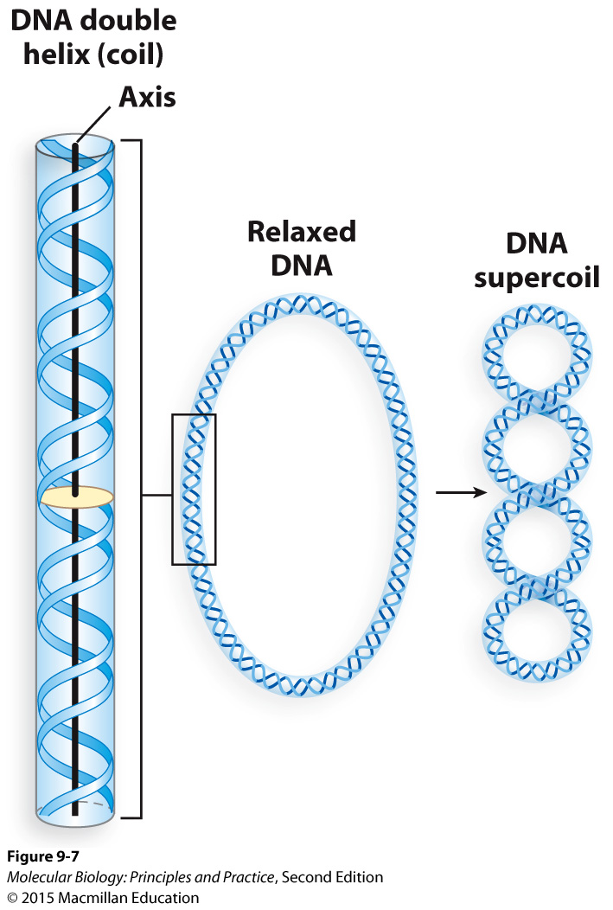
(Note major and minor grooves are easy to visualize here)

Slide 14
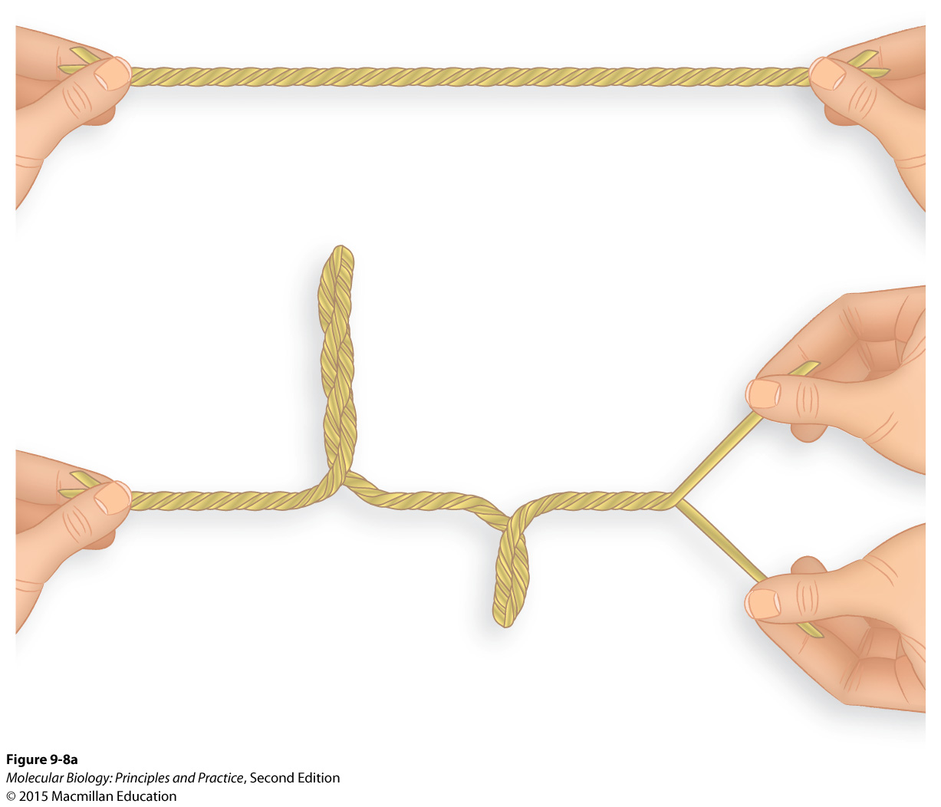
Supercoiling is induced passively by transcription and DNA replication

Slide 15
Supercoiling is induced passively by transcription and DNA replication
Is this positive or negative supercoiling?

Slide 16
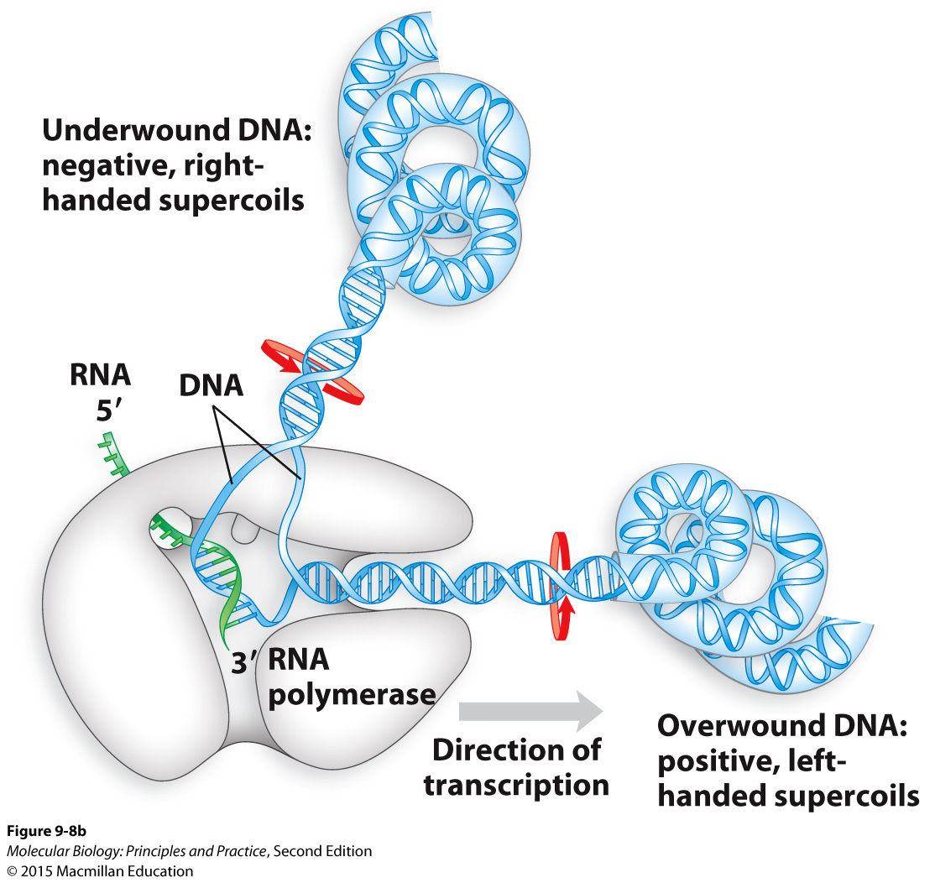
Supercoiling caused by transcription

Slide 17
Supercoiling caused by transcription
Would this matter for a 10 nt transcript? A 10 kb transcript?

Slide 18
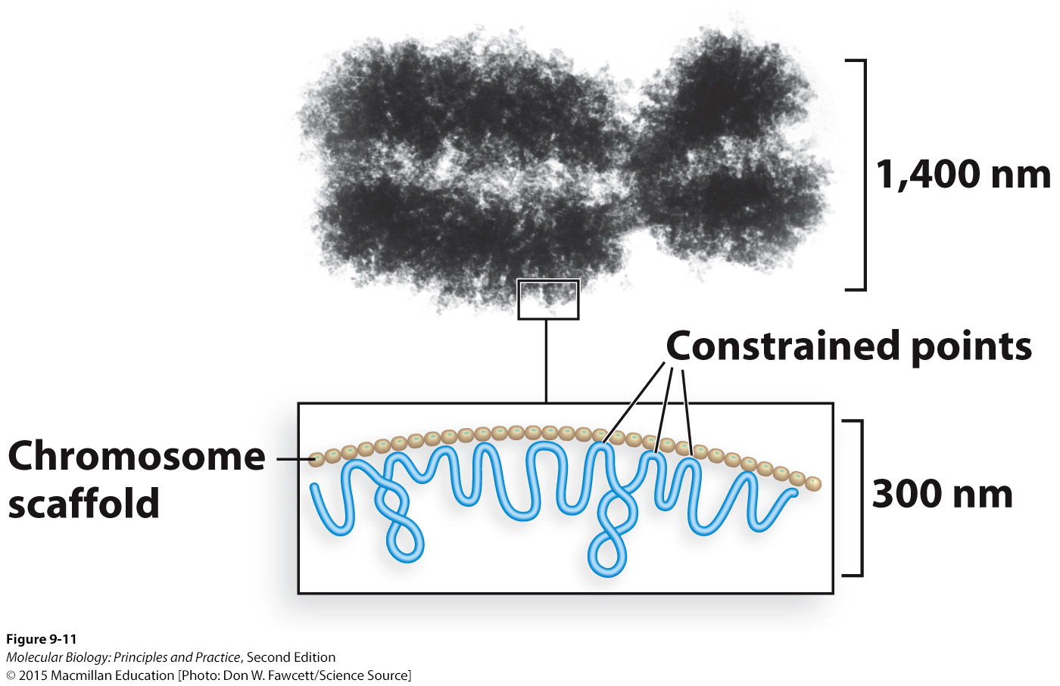
Supercoiling can only occur if the ends of a segment of DNA are fixed in place

Slide 19
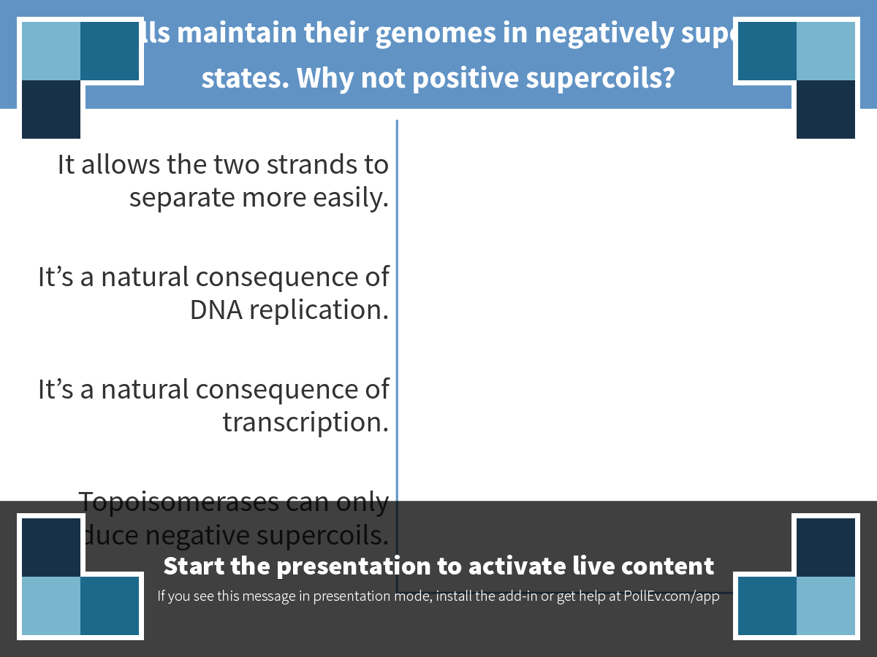
Notes:
Most cells maintain their genomes in negatively supercoiled states. Why not positive supercoils?
https://www.polleverywhere.com/multiple_choice_polls/Ae2jwjZE1DeSDbB

Slide 20
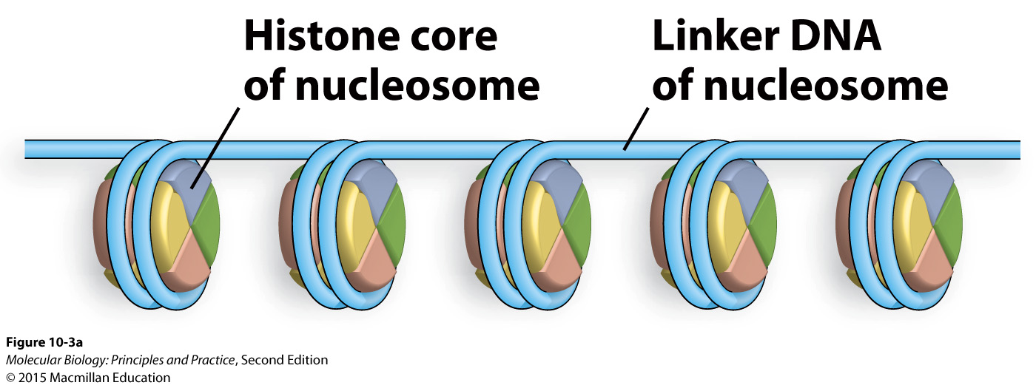
Less obvious, but this DNA is supercoiled too

Slide 21
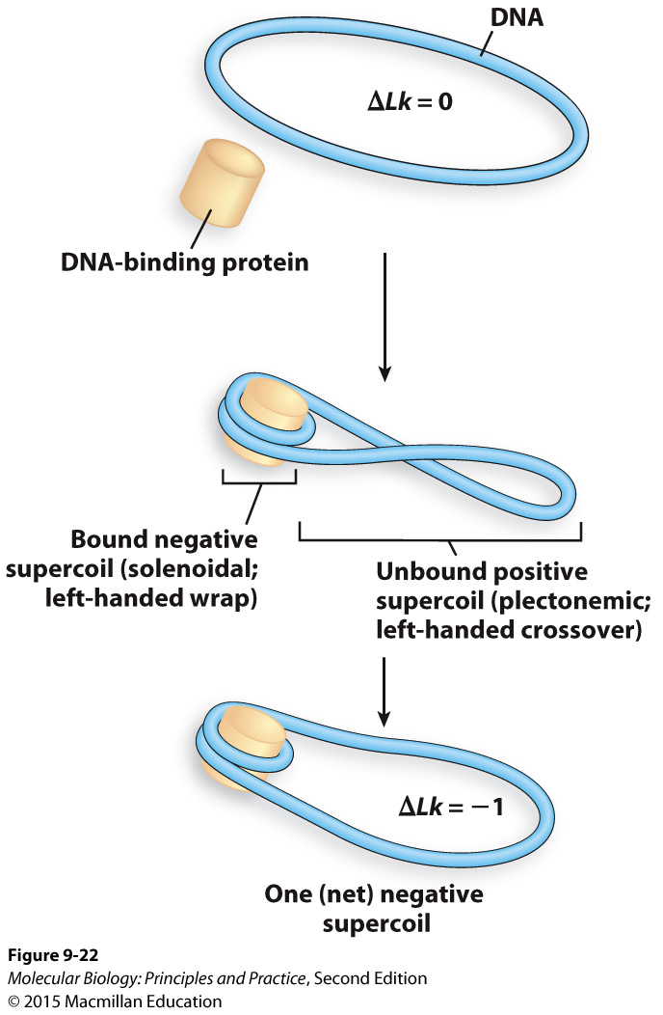
Cells use both protein binding and topoisomerases to introduce and relax supercoils

Slide 22
Class mean: 76.5
Class median: 76

